Slide 1
Using deep learning and time-series forecasting to reduce transit delays

Slide 2
Introduction
Use a publicly available dataset on streetcar delays to create a model to predict and prevent delays
Apply time series forecasting to understand the seasonal nature of delays and deep learning to predict delays
Example of:
Applying deep learning to a raw dataset in structured tabular format
Transforming ill-formed address information into map visualizations
Combining multiple data types (continuous, categorical and text) in a single deep learning model that incorporates embeddings

Slide 3
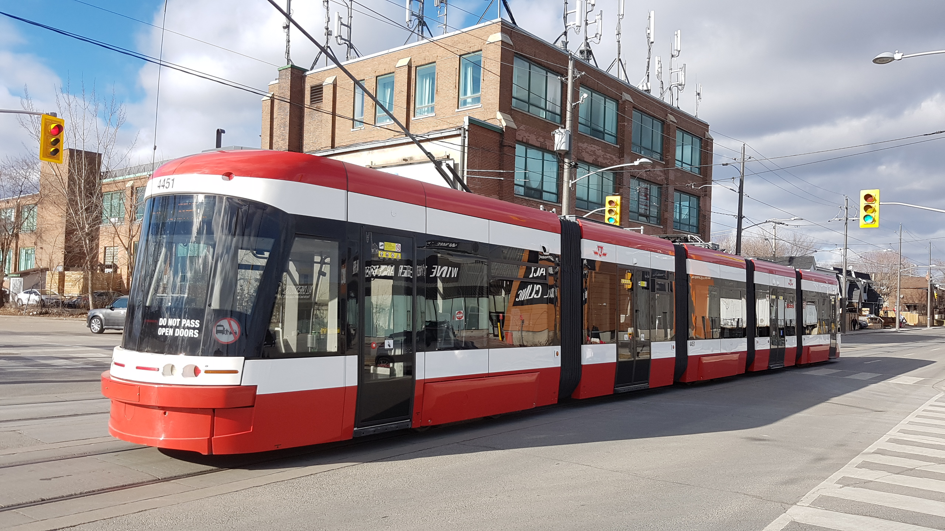
The problem: streetcar delays
Toronto has the biggest network streetcar network in North America
Advantages: greener / lower labour cost than buses; cheaper than subways
Major disadvantage: delays trigger gridlock
Prevent gridlock by predicting and preventing delays

Slide 4
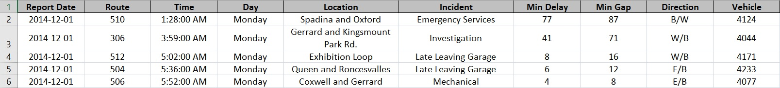
The dataset
~70 k records with details of all streetcar delays since January 2014
No error checking on data entry = messy data:
Invalid routes, vehicles, and direction of travel
Locations are free-form, inconsistent descriptions
Interesting, real-world dataset that demands serious effort to prepare for machine learning

Slide 5
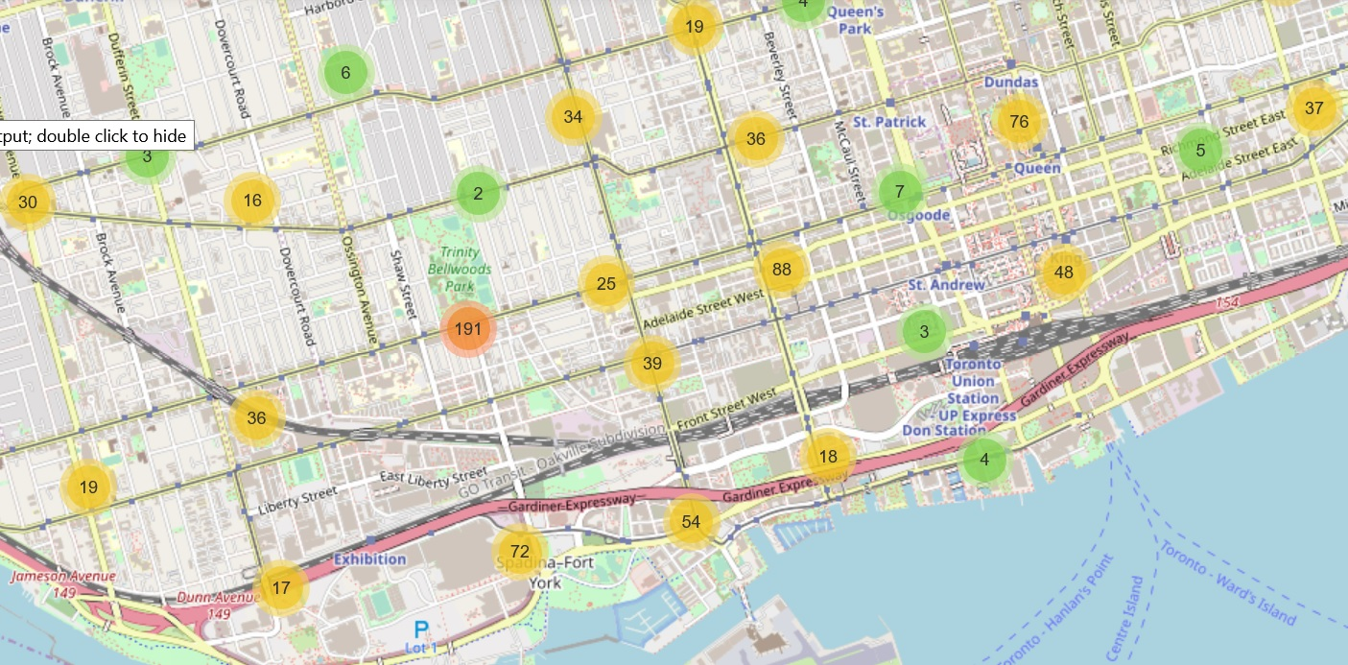
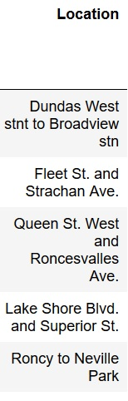
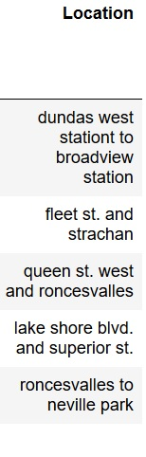
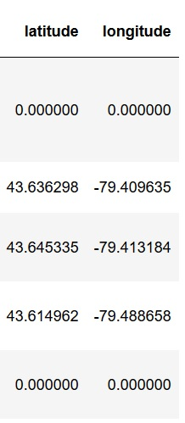
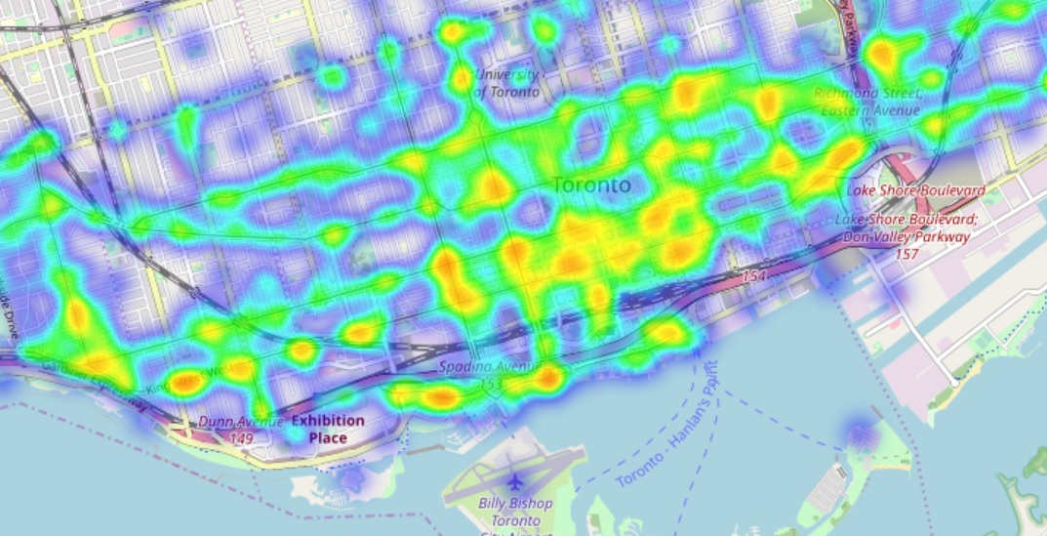
The dataset: locations
Clean custom code
Geocode Google Geocode API
Visualize
Folium
Notes:
The location column was the hardest to process. It required:
General cleanup to get common case, common order of streets for junctions and consistent terms (reduced unique locations by 36%)
Significant effort to apply Google geocoding API to generate latitude and longitude values from the cleaned up addresses
With latitude and longitude values in place, use Folium library to visualize as maps

Slide 6
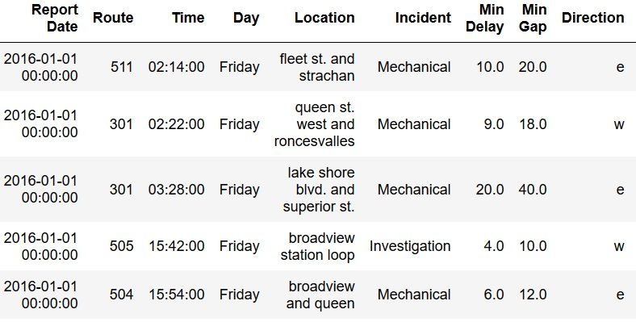
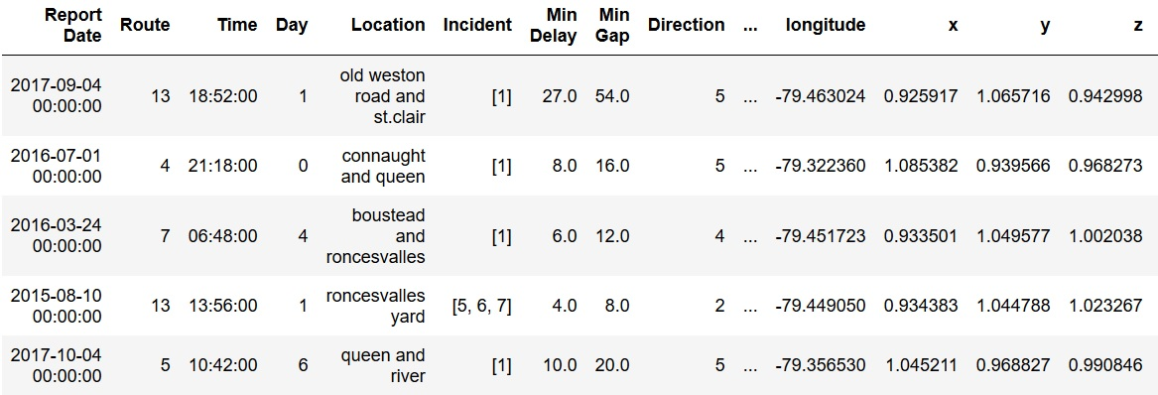
The dataset: transformations
Replace categorical values with numeric IDs
Tokenize text values
Replace latitude and longitude values with x, y, z normalizations
Notes:
The location column was the hardest to process. It required:
General cleanup to get common case, common order of streets for junctions and consistent terms (reduced unique locations by 36%)
Significant effort to apply Google geocoding API to generate latitude and longitude values from the cleaned up addresses
With latitude and longitude values in place, use Folium library to visualize as maps

Slide 7
The model: layers by category
Categorize columns in the dataset:
Continuous: length of delay
Categorical: route, vehicle, direction, time of day, day of week
Text: description of incident
Spatial: location
Automatically build a simple Keras model:
Build model by iterating through columns by type
layers for each column type have distinct characteristics (e.g. GNU for text, embeddings for text and categorical columns)
As long as columns are categorized correctly, the model automatically adapts to new schemas / additional columns
Notes:
The location column was the hardest to process. It required:
General cleanup to get common case, common order of streets for junctions and consistent terms (reduced unique locations by 36%)
Significant effort to apply Google geocoding API to generate latitude and longitude values from the cleaned up addresses
With latitude and longitude values in place, use Folium library to visualize as maps

Slide 8
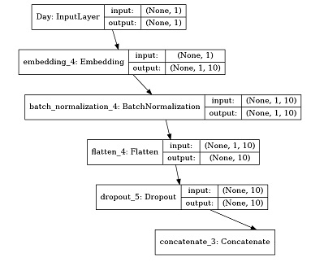
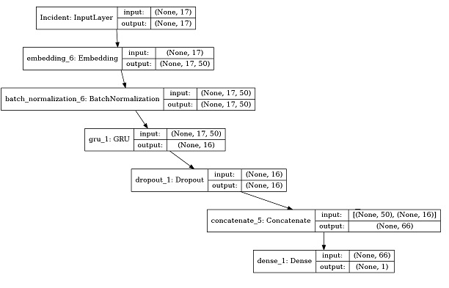
The model: layers by category
Categorical
Text

Slide 9
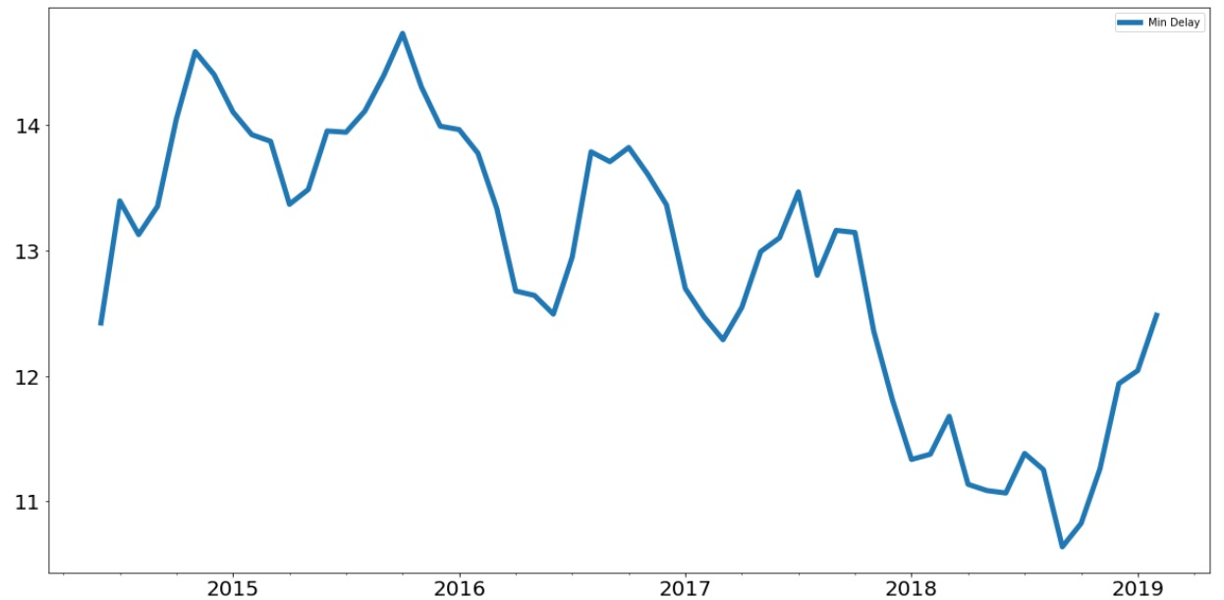
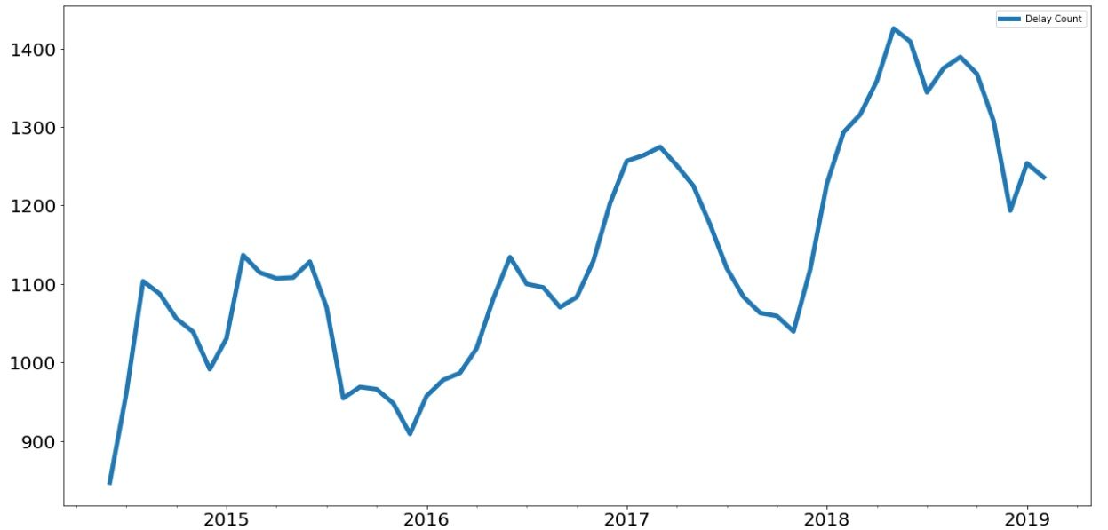
Exploring Time Series
Delay duration averages
Delay count averages

Slide 10
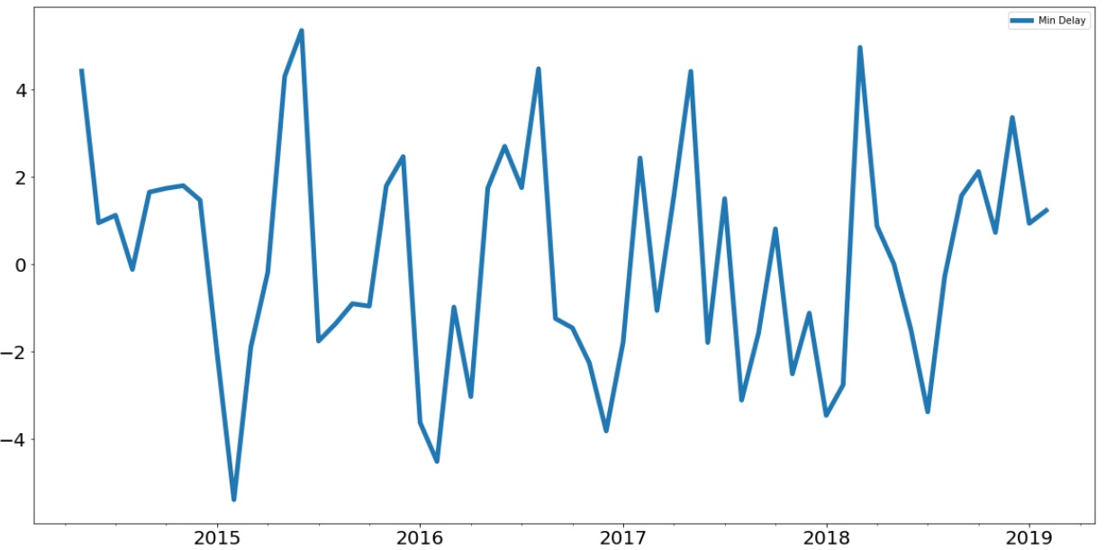
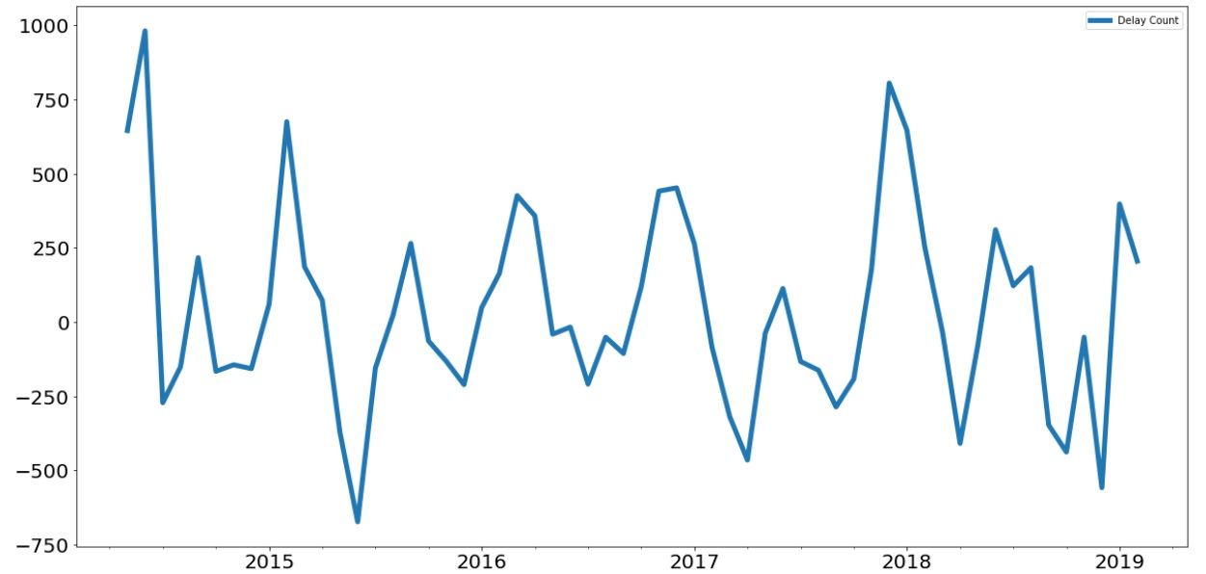
Exploring Time Series
Delay duration seasonability
Delay count seasonability

Slide 11
Code and data for this example
Repo with code and associated material: https://github.com/ryanmark1867/ai_conference_june_2019
Original data source: https://www.toronto.ca/city-government/data-research-maps/open-data/open-data-catalogue/#e8f359f0-2f47-3058-bf64-6ec488de52da

